Slide 1

Enhancing Digital Learning: A Comprehensive Platform for Accessible and Interactive Online Education
Our digital learning platform combines cutting-edge technology and pedagogical best practices to create an engaging and inclusive online education experience. By seamlessly integrating interactive tools and accessible features, we empower learners to thrive in the digital age.
-S.Grishma Chandu(192210566)
-Ch.Sravani(192211962)
Notes:
• Our digital learning platform is designed to enhance the online education experience by combining cutting-edge technology and best practices in pedagogy. • The platform seamlessly integrates interactive tools and accessible features to create an engaging and inclusive learning environment for all students. • By empowering learners to thrive in the digital age, we aim to make online education more accessible and interactive than ever before. • The image on the left visually represents this digital learning experience, depicting students studying on laptops in a modern, clean, and warm setting. • As you can see, our comprehensive platform is poised to transform the way students learn and succeed in the online space.

Slide 2
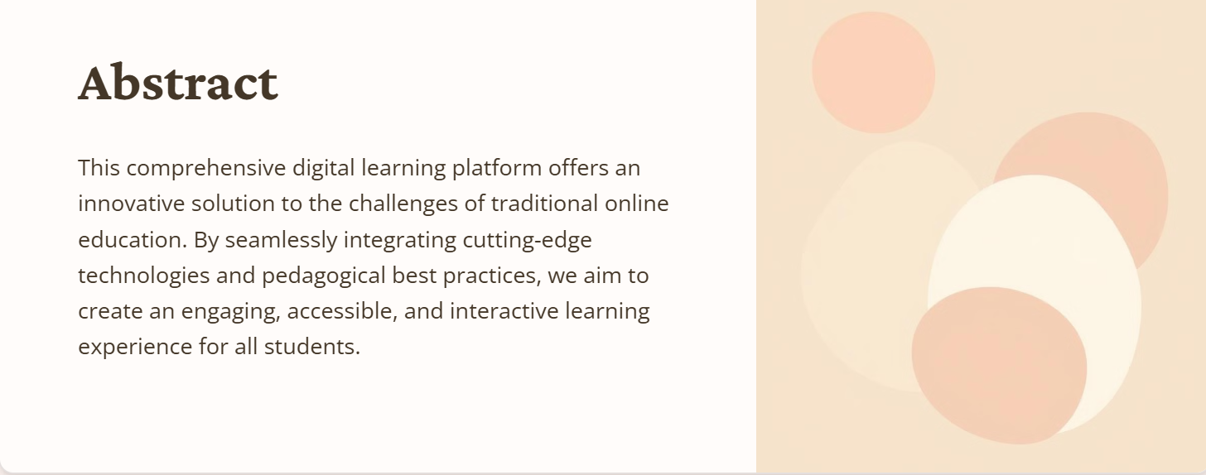

Slide 3
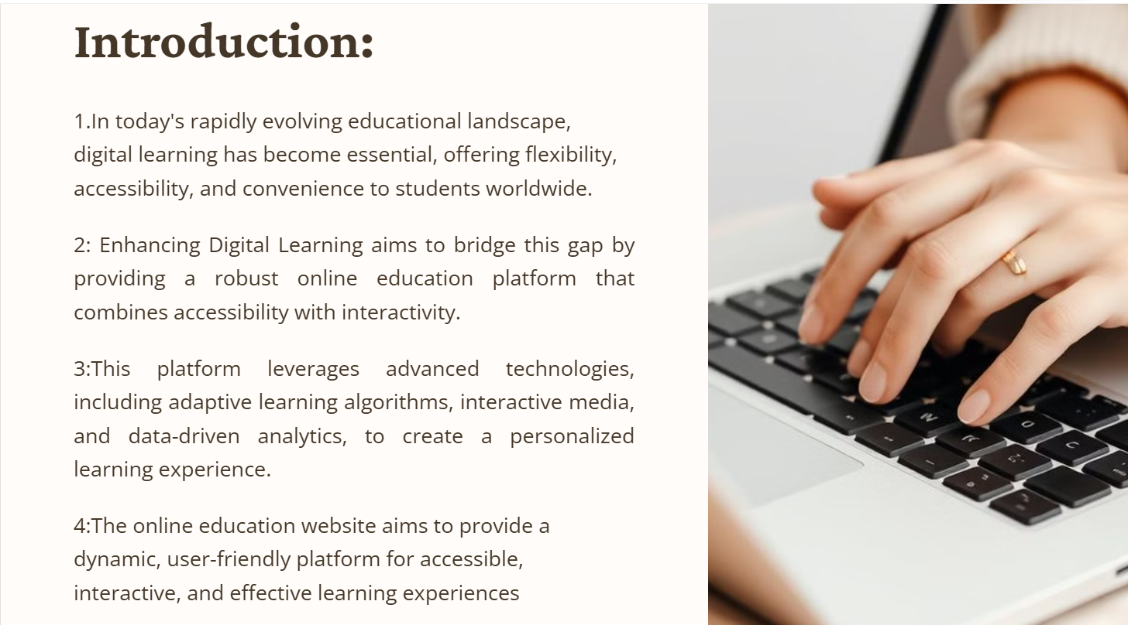

Slide 4

Challenges of Traditional Online Learning
1
Passive Experiences
2
Accessibility Barriers
Lack of interactivity and limited opportunities for collaboration can lead to disengagement.
Inaccessible platforms and materials exclude learners with diverse needs and abilities.
3
Technological Hurdles
Complex systems and frequent technical issues can hinder the learning process.

Slide 5
Benefits of an Integrated Digital Learning Platform
Content Delivery: Enable educators to upload, organize, and deliver multimedia content (videos, quizzes, PDFs, etc.) easily. Each course will offer modular content
Analytics and Progress Tracking: Incorporate a dashboard for learners to track their course progress, scores, and completion status, along with analytics for instructors to
Interactivity and Engagement: Integrate interactive tools like discussion boards,real-time quizzes, and live chat support to foster a collaborative learning environment.
User Experience: Create a visually appealing and easy-to-navigate website that encourages interaction and engagement. Responsive design principles will ensure compatibility across devices, including desktops, tablets, and smartphones.
that learners can access at their own pace.
monitor student performance.
Notes:
user experience

Slide 6

Key Features of Our Platform
Virtual Classrooms
Multimedia Content
Immersive video conferencing with interactive whiteboards and breakout rooms.
A rich library of engaging videos, animations, and multimedia resources.
Collaborative Tools
Adaptive Learning
Real-time document editing, group projects, and discussion forums.
Personalized learning paths and AI-driven recommendations for each student.
Course Management System: Educators can upload and organize course content,
including videos, documents, and quizzes, allowing for structured and modular
learning experiences.

Slide 7
Proposed system and Existing system
Existing System
Proposed System
-Rigid and outdated platforms with limited interactivity and accessibility.
- Enhanced Personalization: Adaptive learning pathways adjust content based on individual progress, making the learning experience more personalized.
-These systems may not provide a truly personalized experience, and their accessibility features can be limited, restricting ease of use for some learners.
- Increased Accessibility: Features like text-to-speech, closed captions, and multi-language support ensure inclusivity.
-existing systems often lack an integrated analytics suite, making it harder for instructors to gauge student engagement and tailor content effectively
- Better Interactivity: Interactive elements such as real-time quizzes, discussion boards, and live chat support promote engagement.
- Advanced Analytics: An integrated analytics suite allows instructors to monitor and analyze student performance and engagement.
- Secure Payment and Data: Enhanced security measures for transactions and data protection ensure safe use for paid courses.

Slide 8






Tools Description
Front-End: HTML5, CSS3, JavaScript, Bootstrap for responsive design
Back-End: Node.js, Django, or PHP for server-side processing.
Database: MySQL or MongoDB for user data and course content storage
Media Integration: Support for video hosting platforms (YouTube, Vimeo) and interactive content creation tools.
Analytics:
Google Analytics and custom tracking features to monitor user activity and engagement levels.

Slide 9
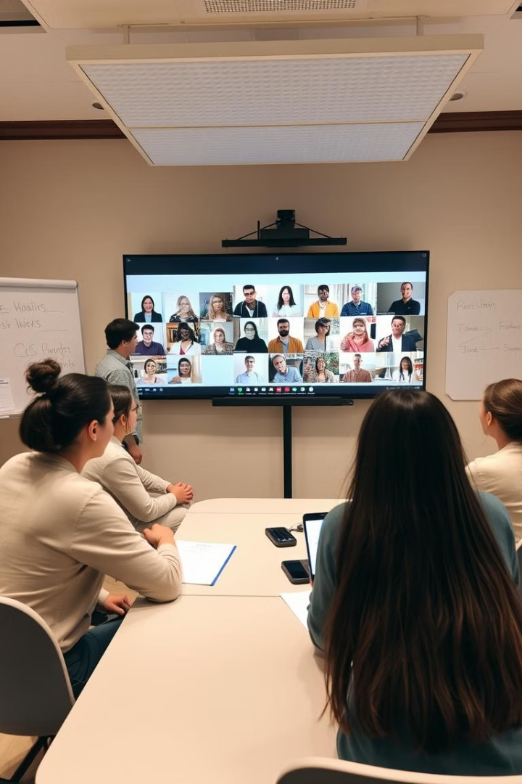
Collaborative Learning Spaces
1
Virtual Classrooms
Immersive video conferencing with shared whiteboards, breakout rooms, and screen sharing.
2
Group Projects
Seamless real-time collaboration on documents, presentations, and other digital artifacts.
3
Discussion Forums
Engaging discussions, peer feedback, and knowledge sharing among learners and instructors.

Slide 10





Functionalities
Adaptive Learning
Multimedia Content
Collaborative Tools
Accessibility Features
AI-powered personalized recommendations and learning paths for each student.
Engaging videos, interactive simulations, and a wide range of learning resources.
Real-time document editing, group projects, and discussion forums for enhanced teamwork.
Robust accessibility options to ensure inclusive access for learners of all abilities.

Slide 11
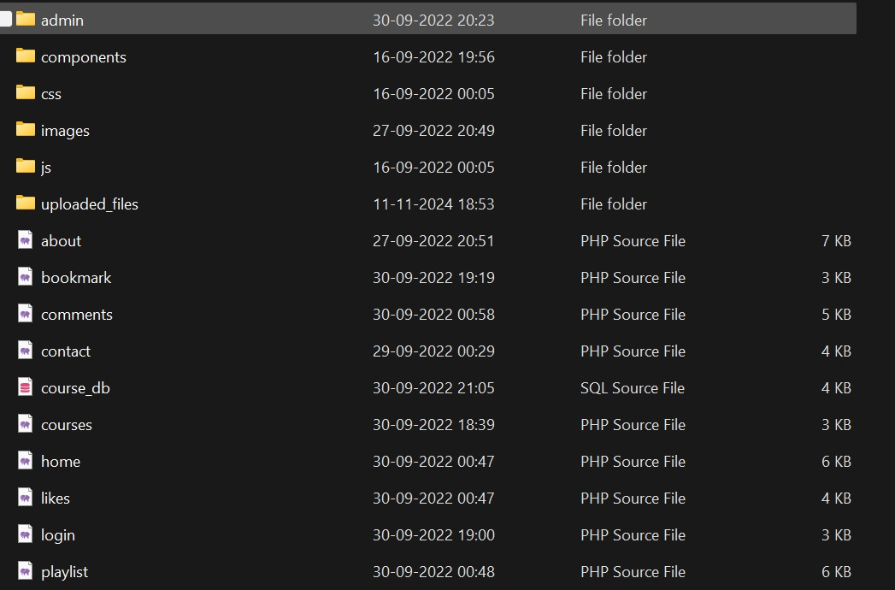
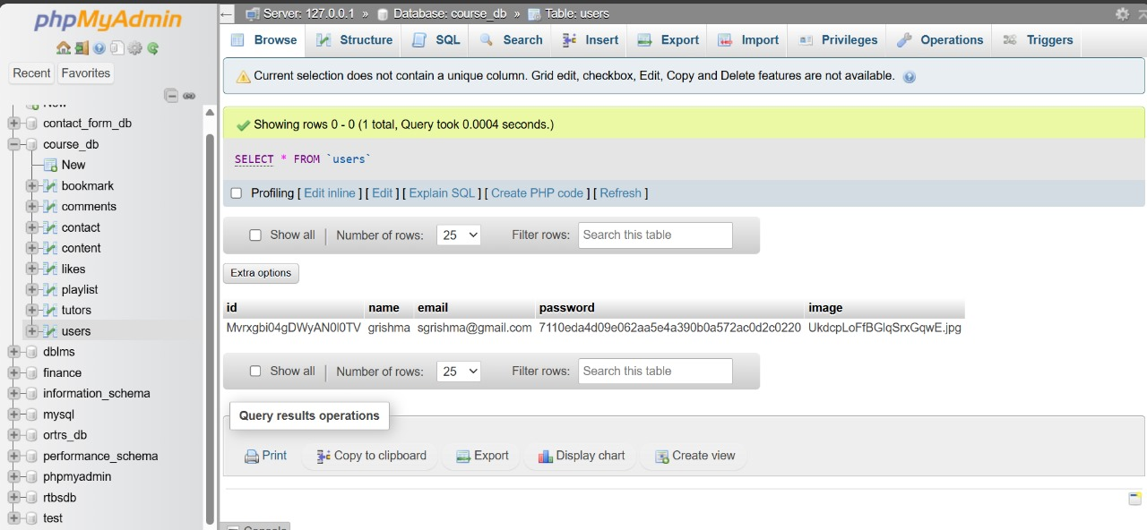
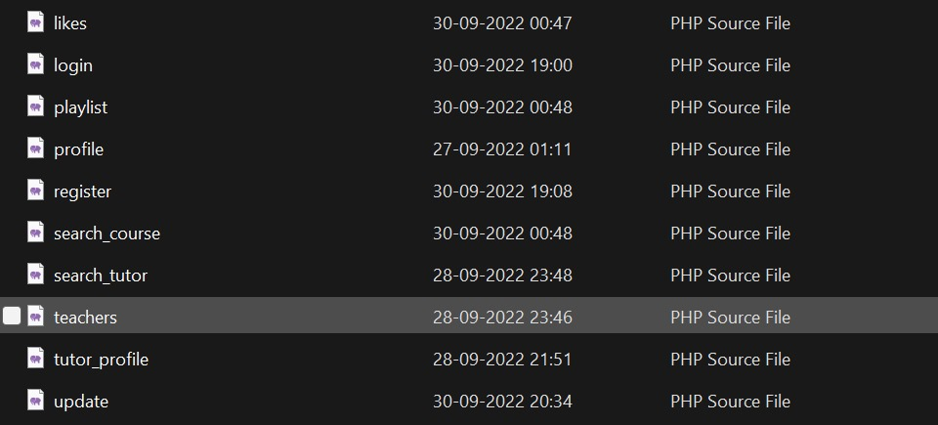
Implementation:

Slide 12
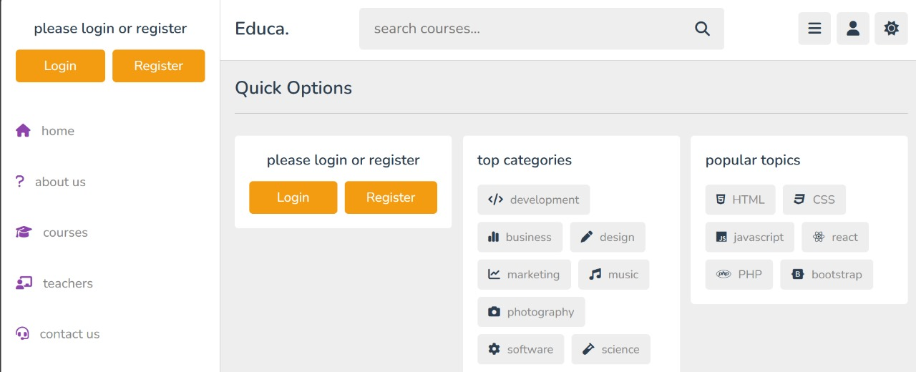
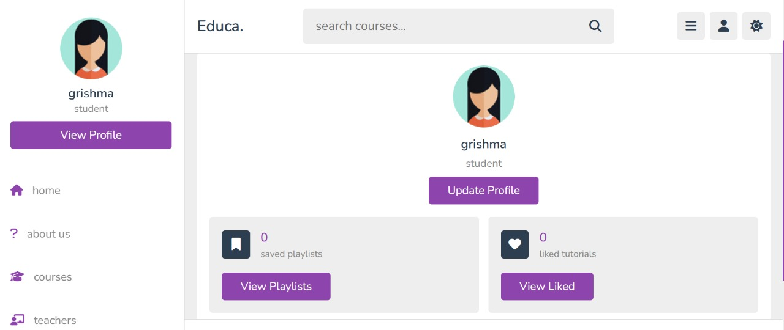
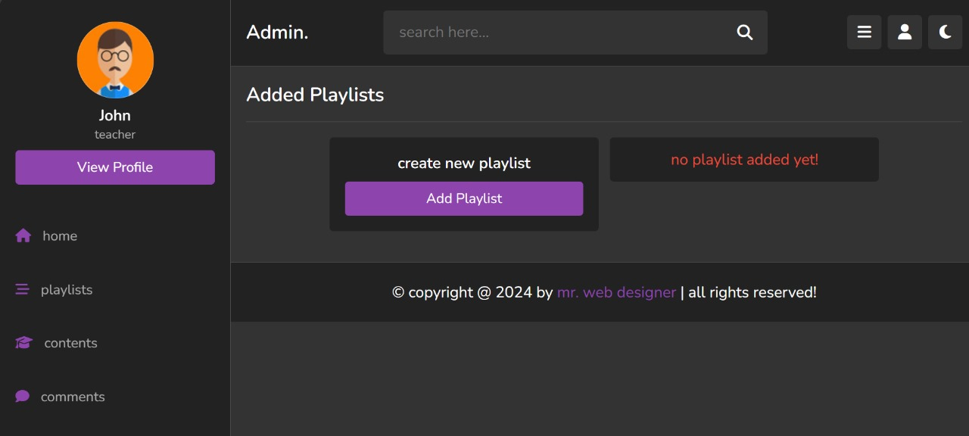
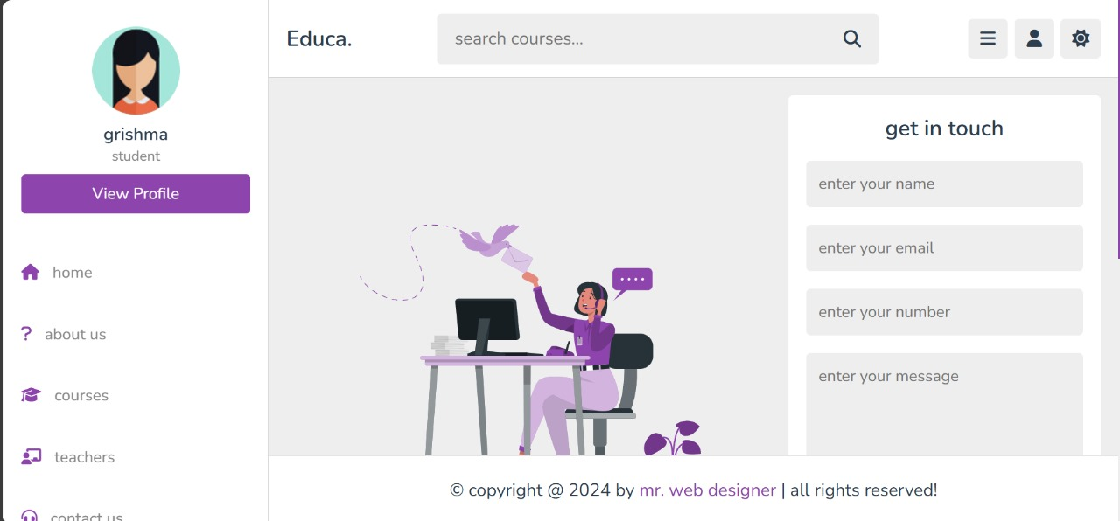
Output:

Slide 13
